Slide 1

WEATHER DISEASE
To discuss the issue of global climate and disease

Slide 2
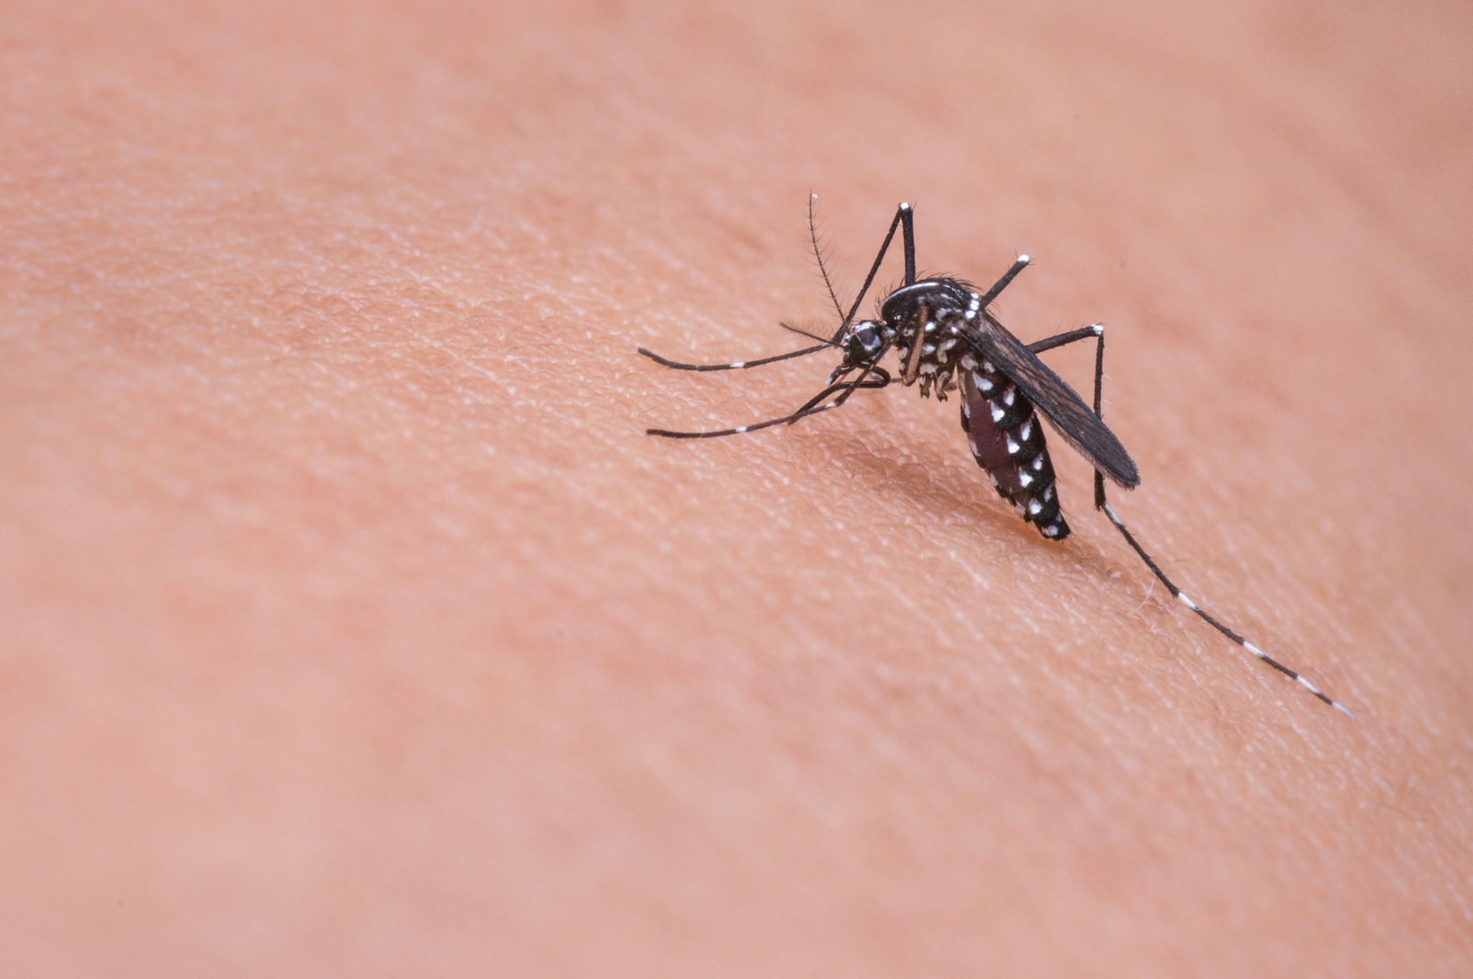
Dengue
Alarm
For Travelers
Show disaster and disease information from global

Slide 3
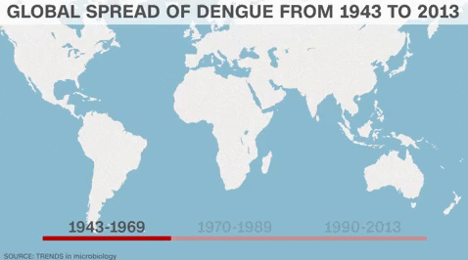
Dengue fever cases are increasing year by year

Slide 4
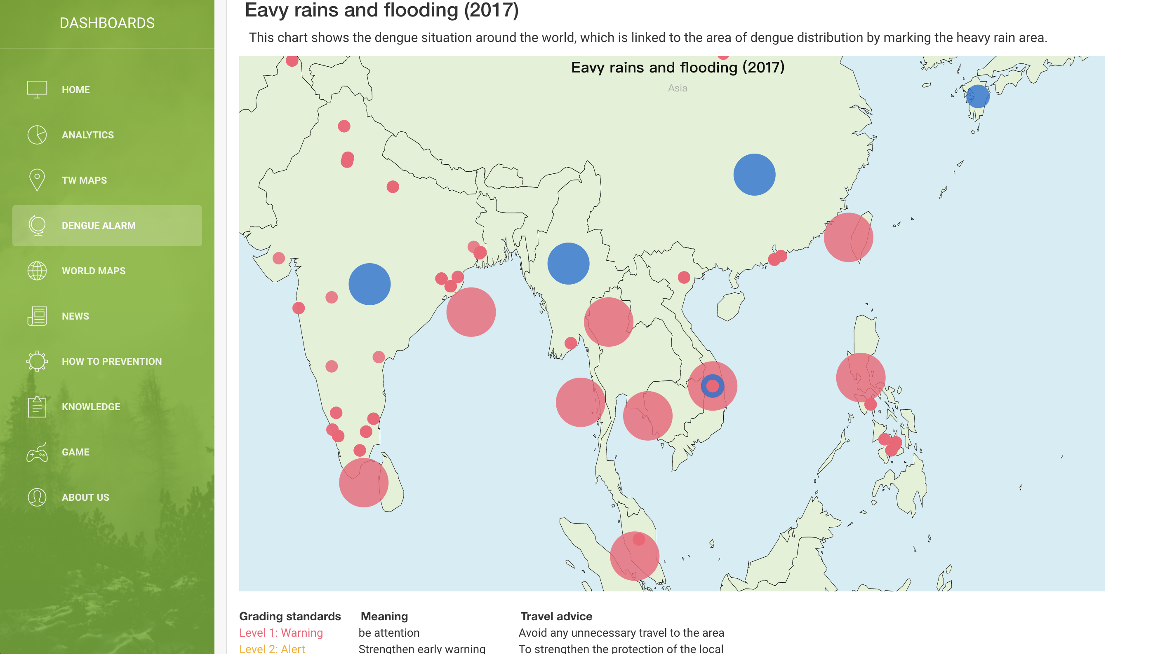
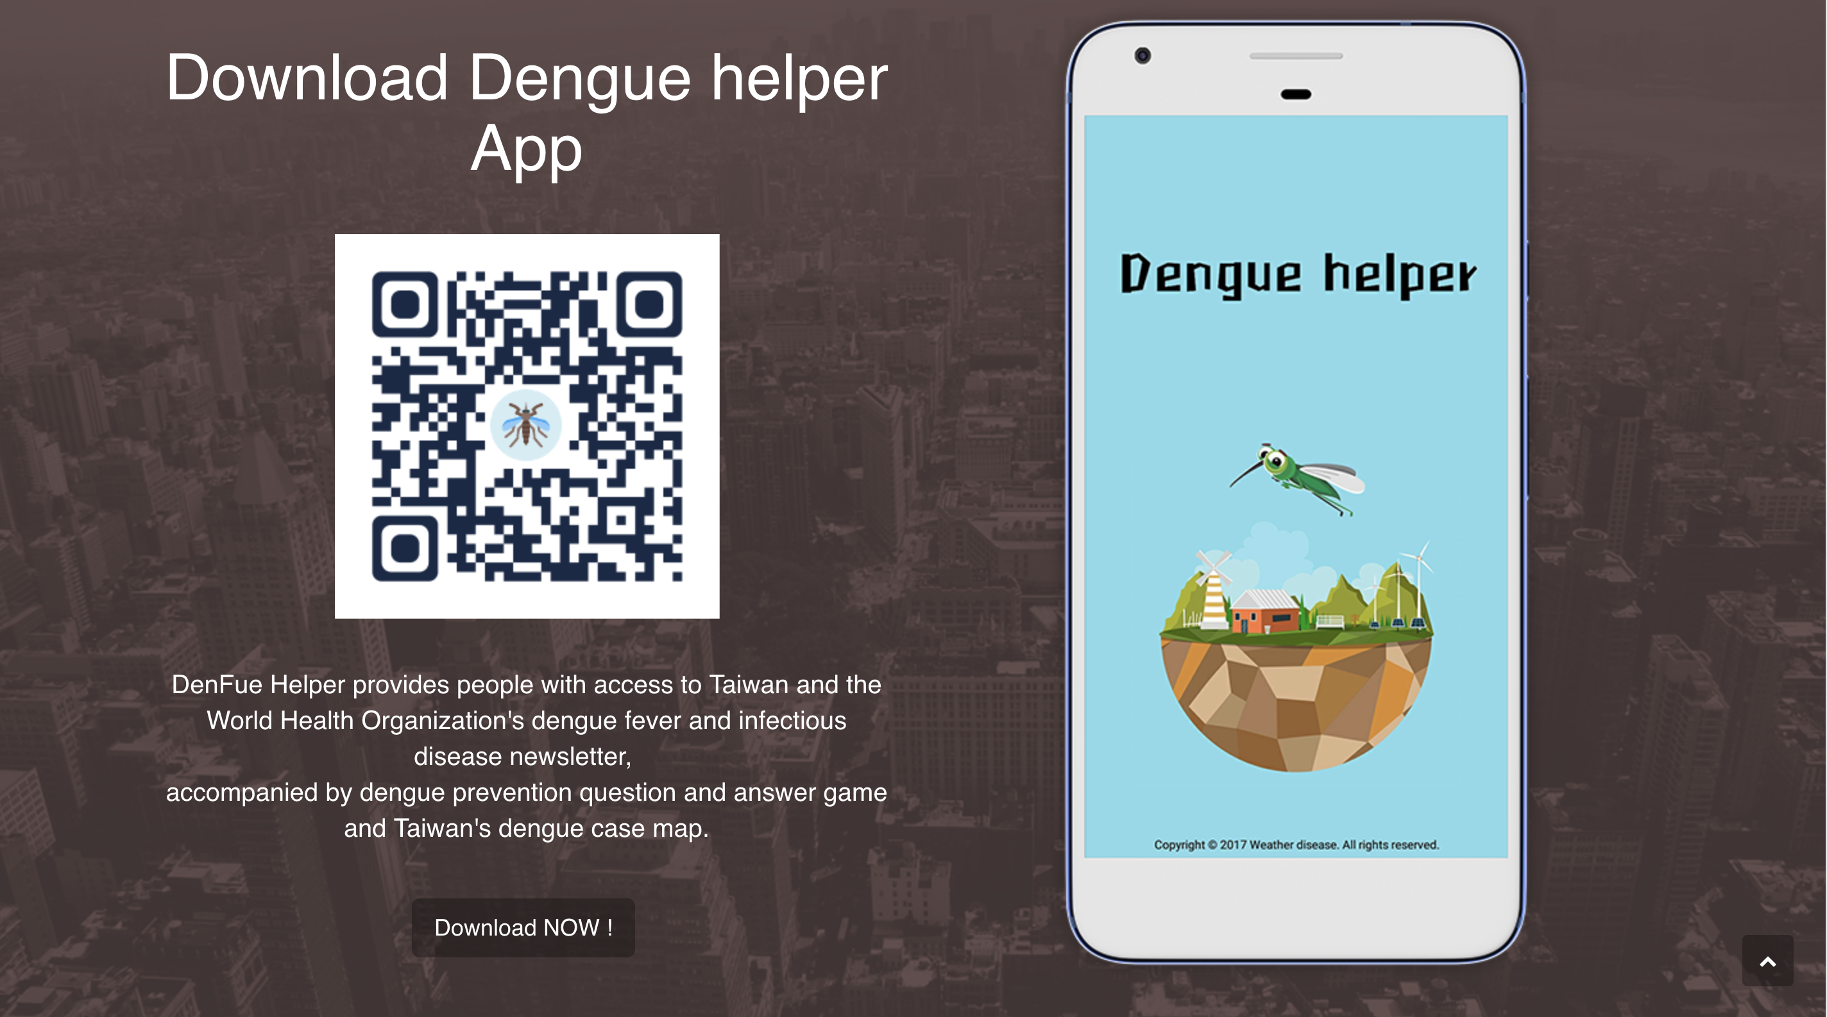
Website
App

Slide 5
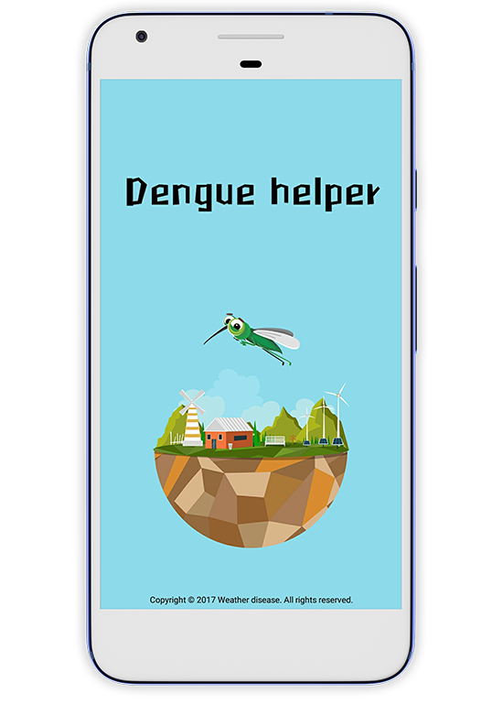

Dengue Helper
Global real-time weather
Real-time disease news
Global map
Taiwan dengue
Dengue fever prevention

Slide 6
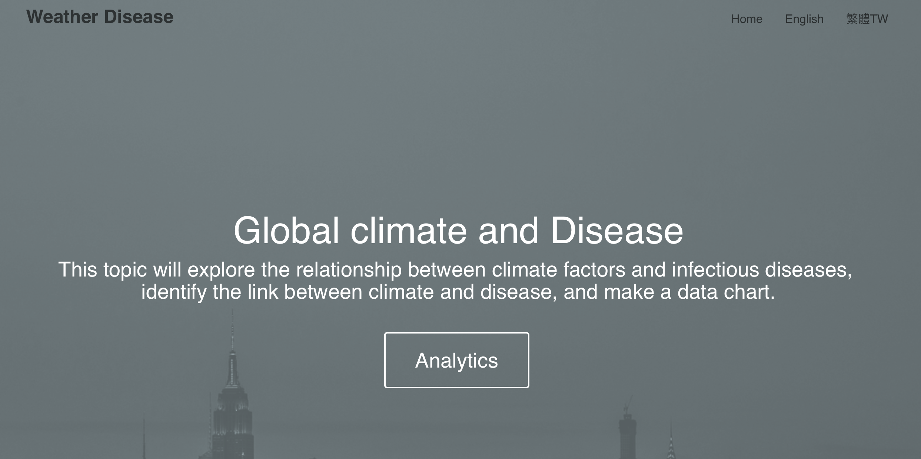
Weather Disease WebSite
URL : http://4xtw.tk

Slide 7
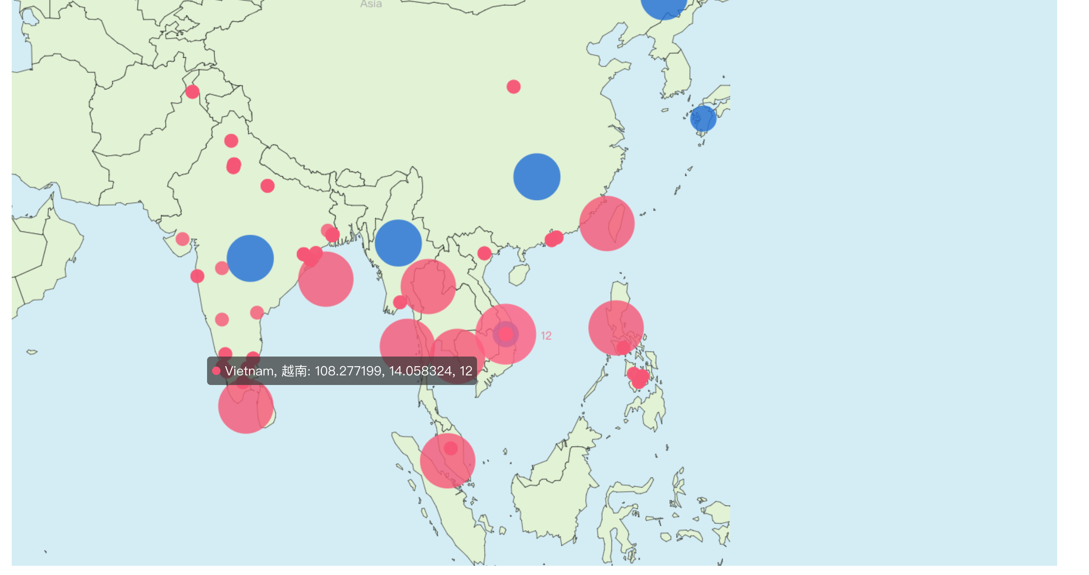
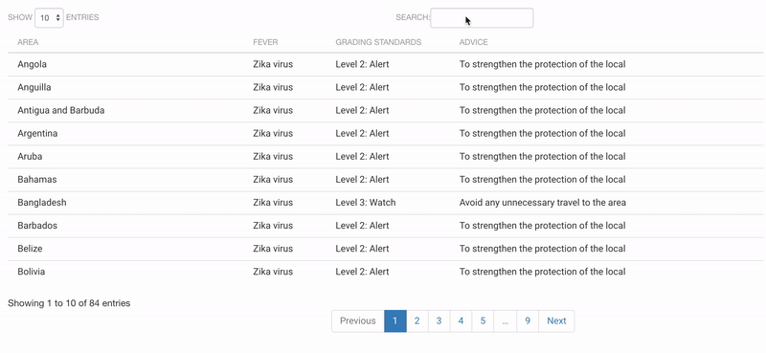
WEB Introduction
Map of disease and disaster alert
Table of diease alerm form global

Slide 8
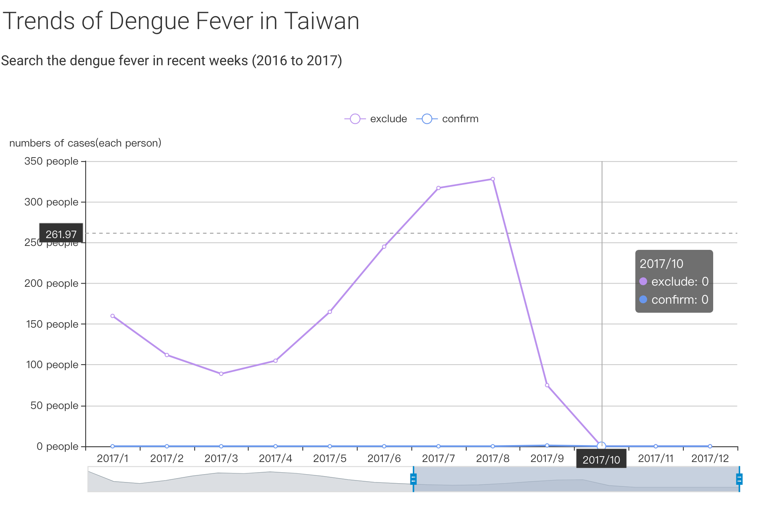
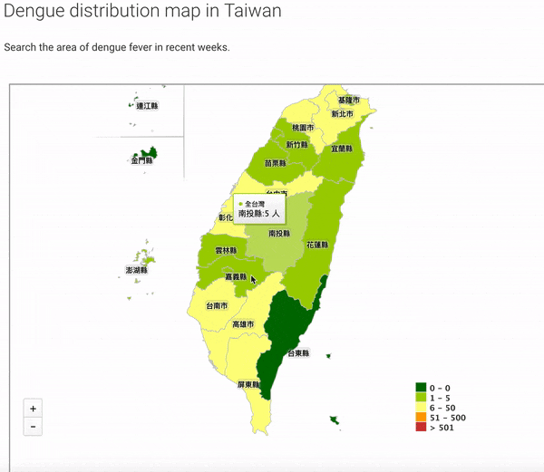
Statistical chart of Dengue cases in Taiwan in recently

Slide 9
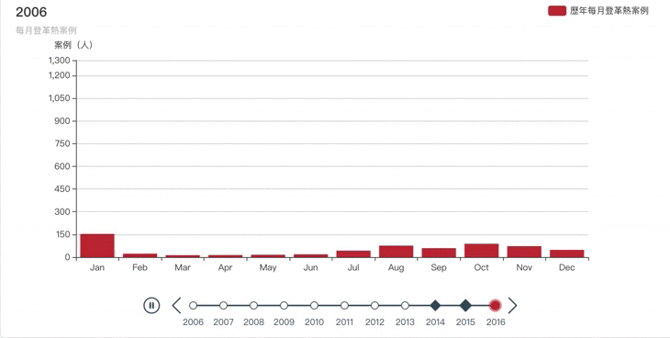
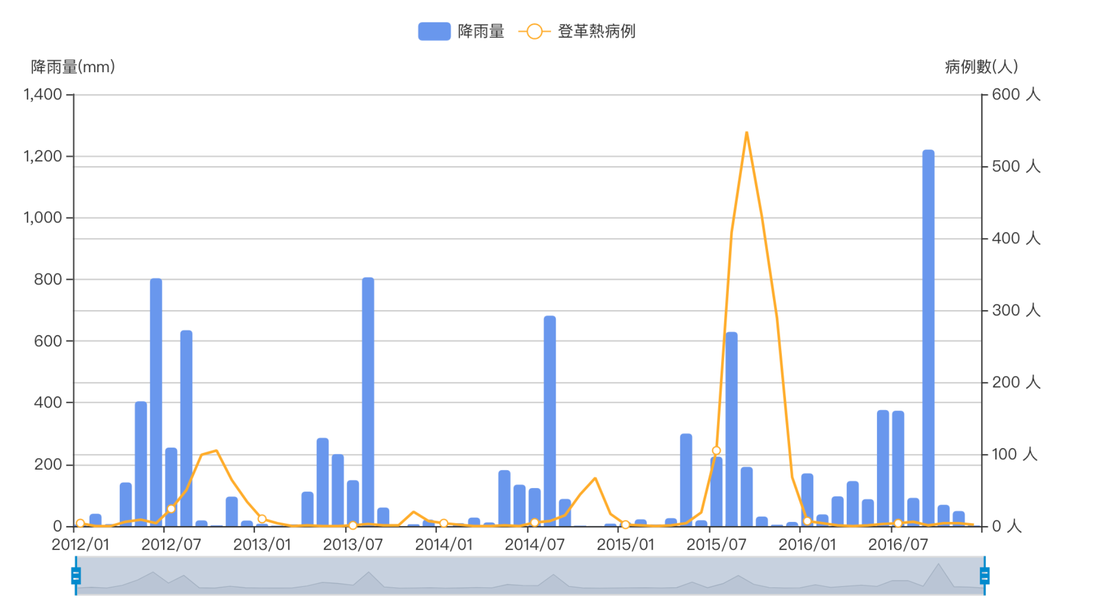
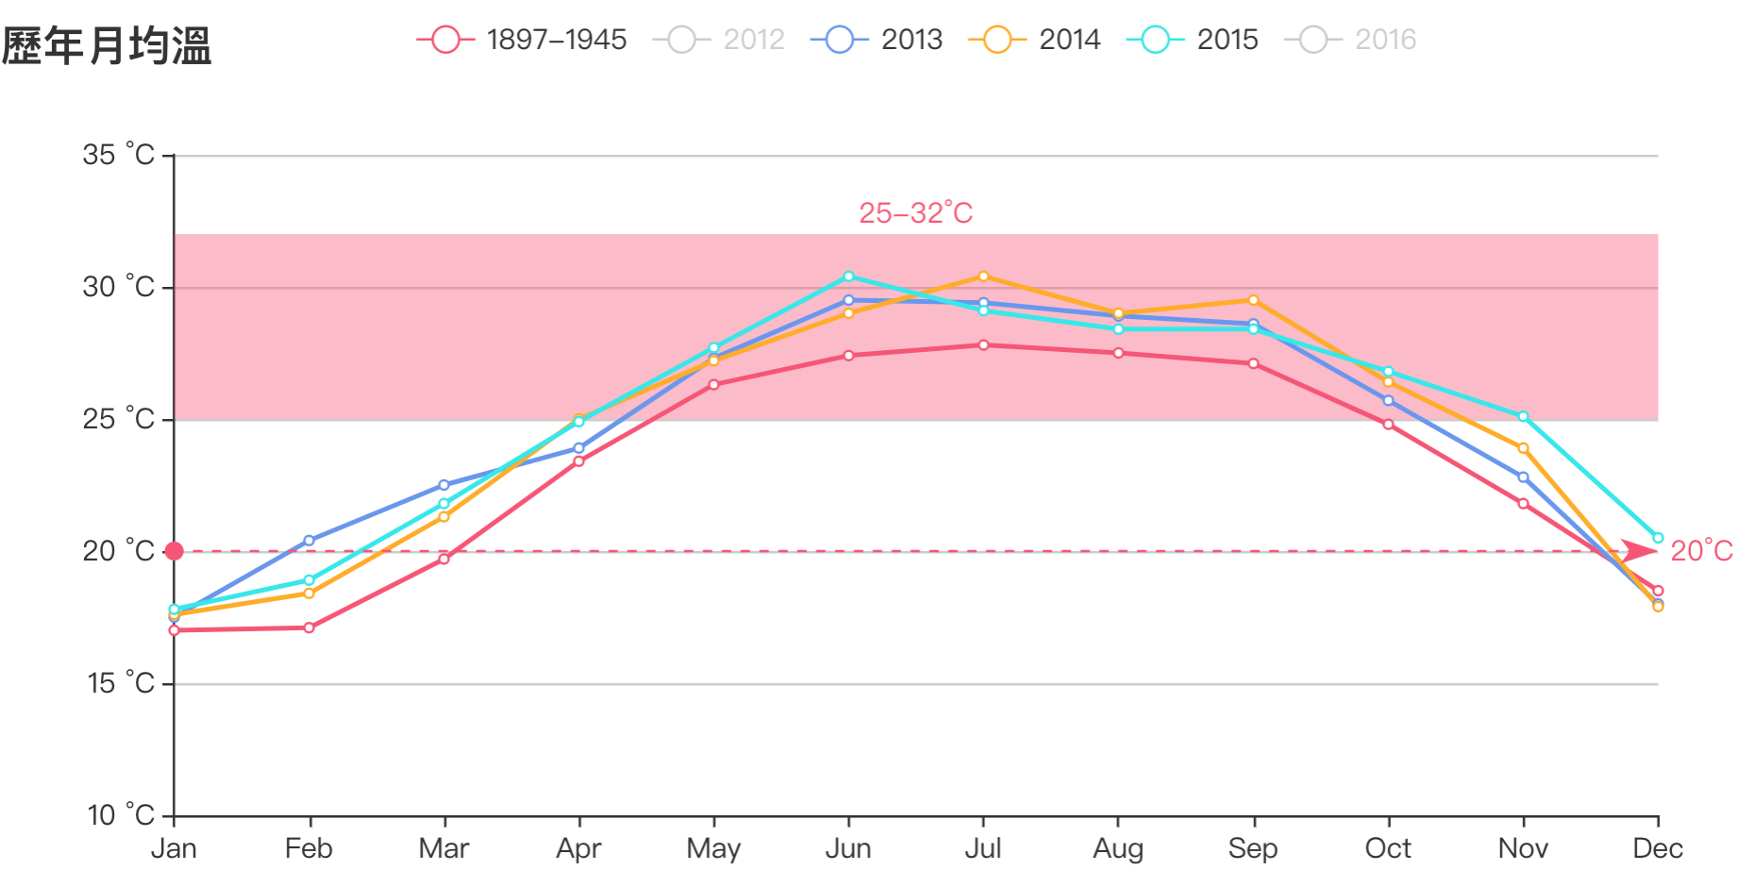
STATISTICS OF DENGUE CASES IN TAIWAN
Statistical chart of Dengue and Climate in Taiwan
COMPARISON CHART OF
DENGUE CASES AND RAINFALL IN TAINAN
COMPARE CHAERT OF MOUTHLY TEMPERATURE IN TAINAN

Slide 10

DATASET
Taiwan's Open Data
Taiwan CDC Open Data Portal
Area,Age,Gender Statistics -Dengue
Taiwan CDC News
Central Weather Bureau - open platform
Global Open Data
WHO Disease Outbreak News
Yahoo Weather API
Japen CDC Dengue Open Data
Thailand CDC Dengue Open Data

Slide 11

THANK YOU

